Slide 1
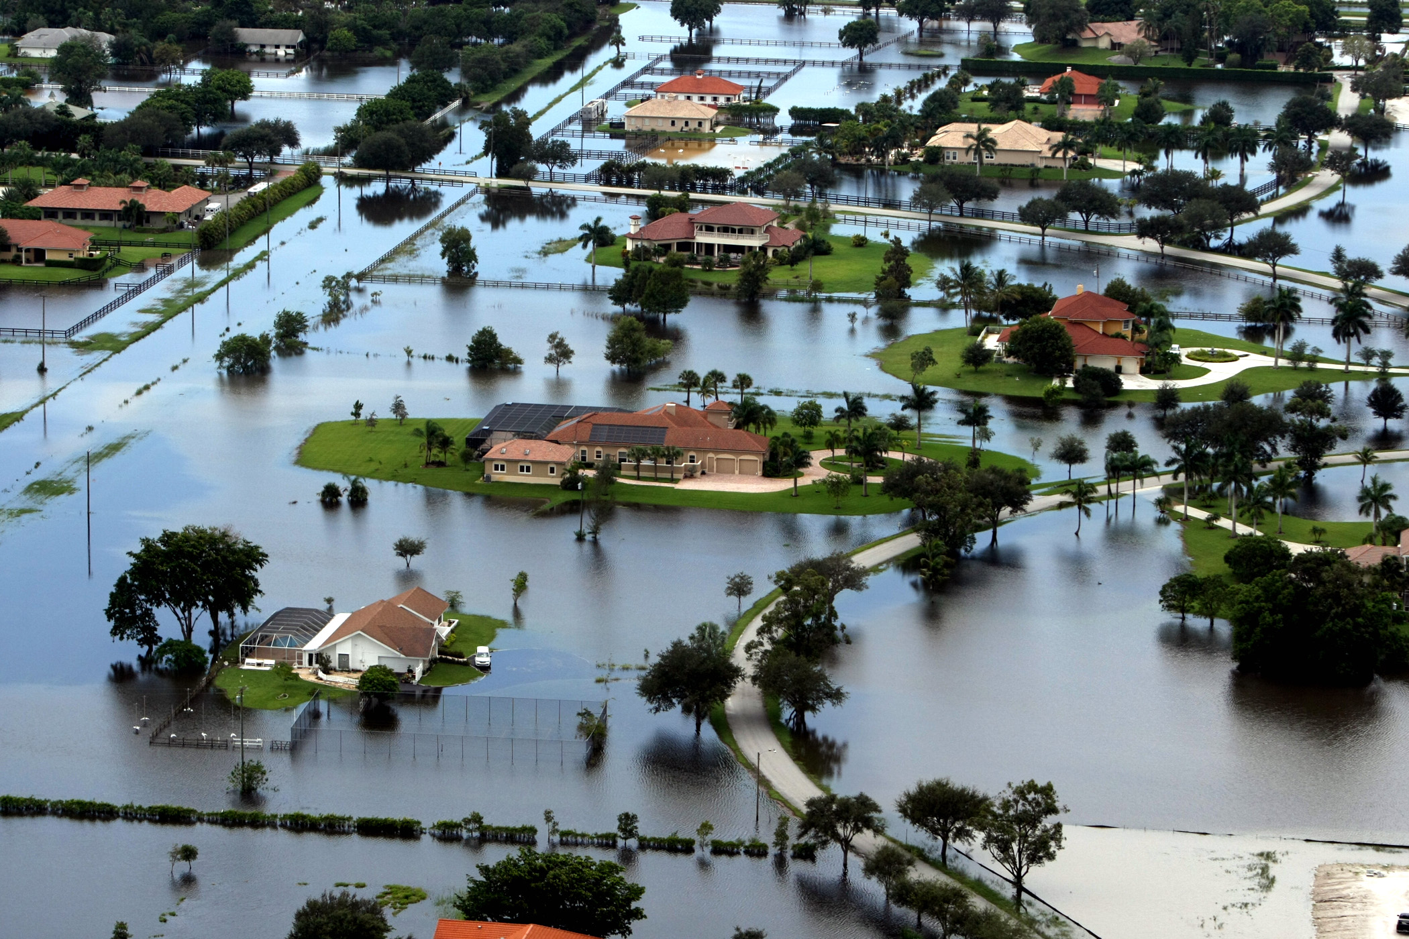
Flooding in Florida
Marina Blanke
Vishal Vatnani
Jagadeesh Prabhakaran
Xinbei Zhu
Jonathan Oh
Dan Liu

Slide 2


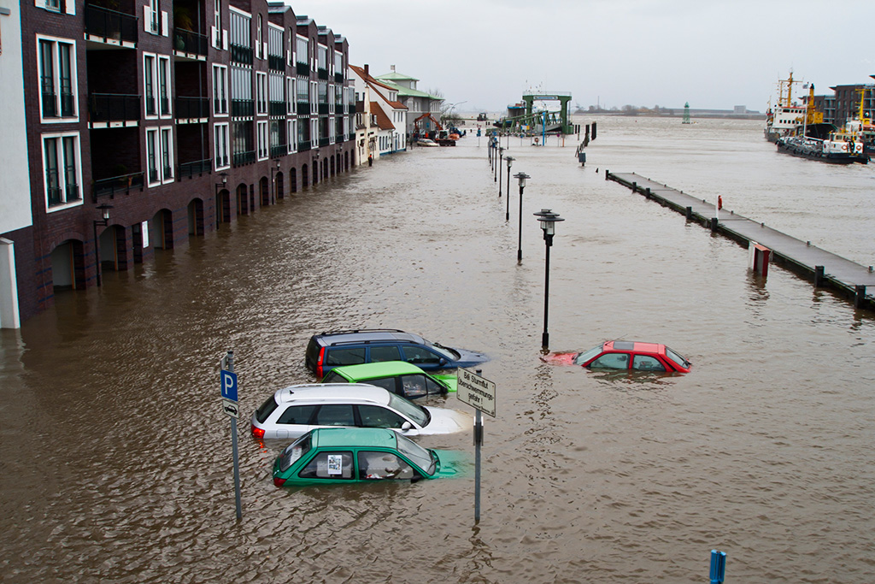
Impacts of flood on overall population and economy
Determine geographical locations in Florida with the highest human mortality rates and/or the highest economic loss.
Determine the environmental and civil factors that are common among those areas with high losses.
Come up with a risk model of what geographical locations in Florida are most likely to suffer a loss from future floods.
Notes:
Remember to get census data from 2000

Slide 3
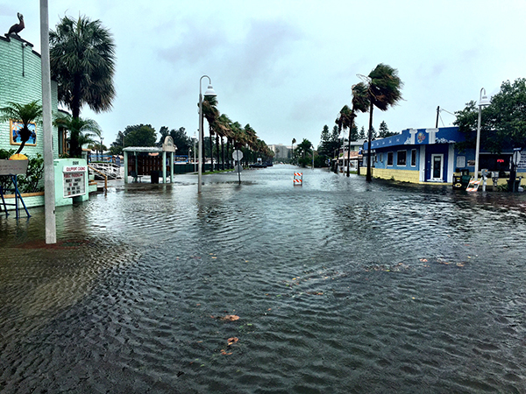
What Have We Done?
Limited scope of project from world map to just the state of Florida
Added Emergency Response data to current data sets
Police Stations
Fire Stations
Hospitals
Added School data to mark dense population areas

Slide 4
What Have We Done?
Managed to get Census Data for Florida from the year 2000
Created Population Density for Counties on the shapefile for Florida
Rasterized Emergency services point data

Slide 5

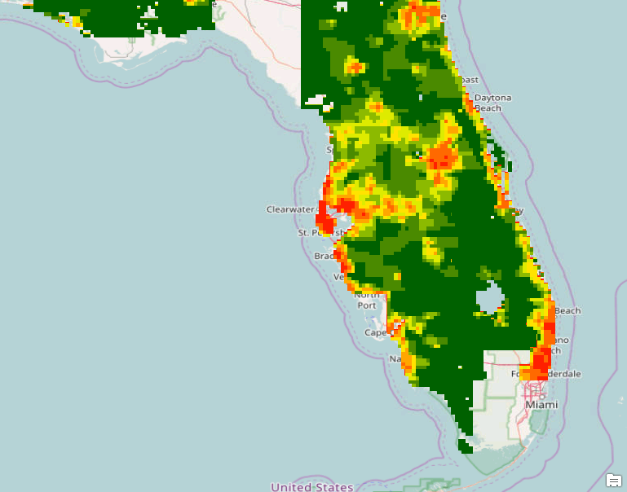
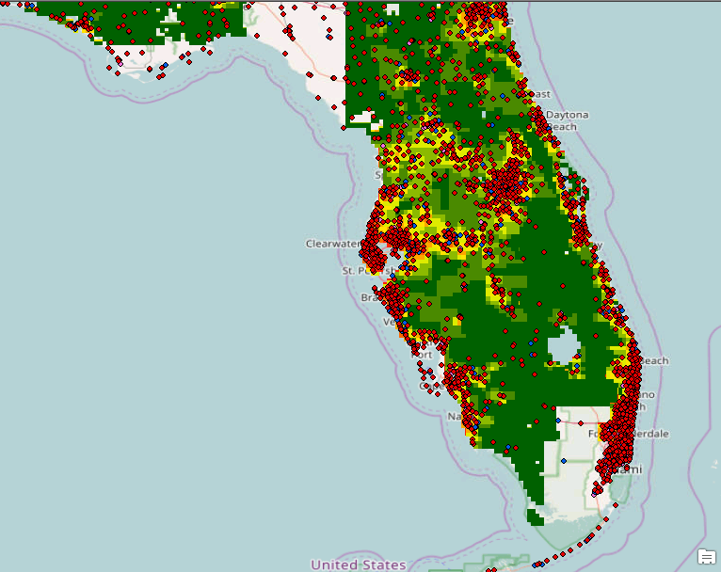
Flooding Mortality Rate
Flooding Mortality Rate Map
Flooding Mortality Rate Map with
Fire Stations, Police Stations, and Hospitals/Clinics

Slide 6
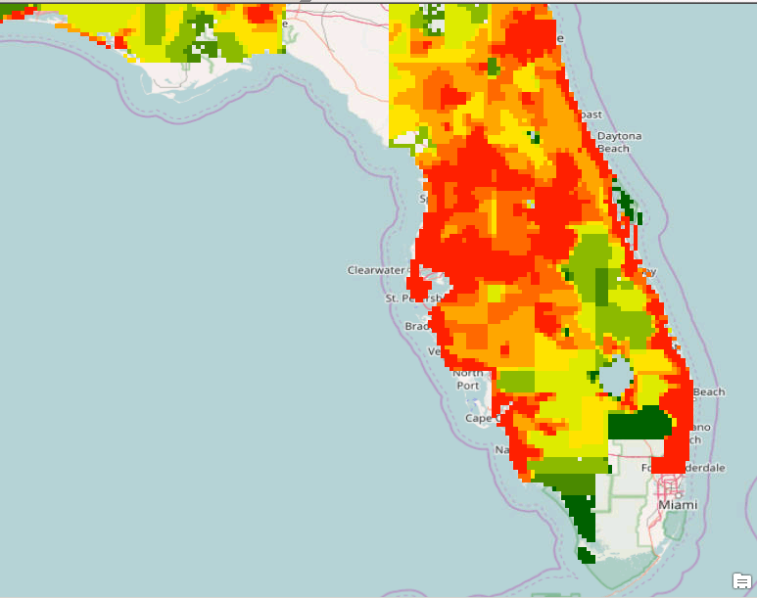
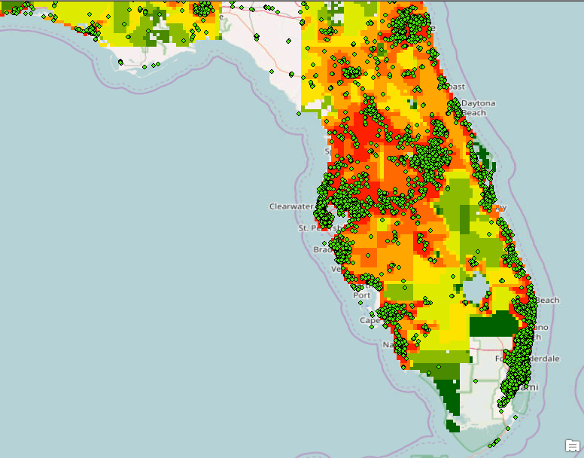
Total Economic Loss from Flooding
Flooding Economic Loss Map
Flooding Economic Loss Map with
Schools marked

Slide 7
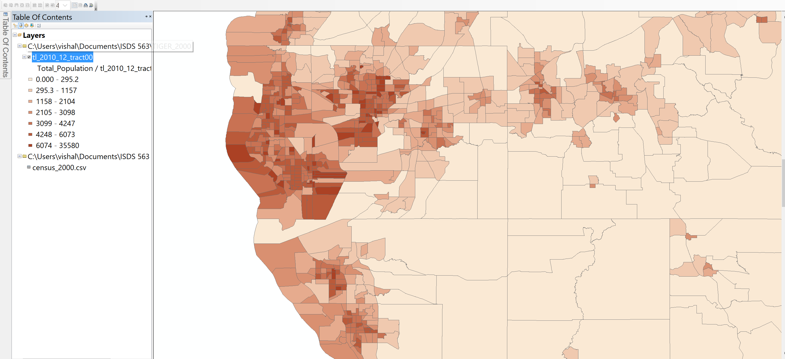
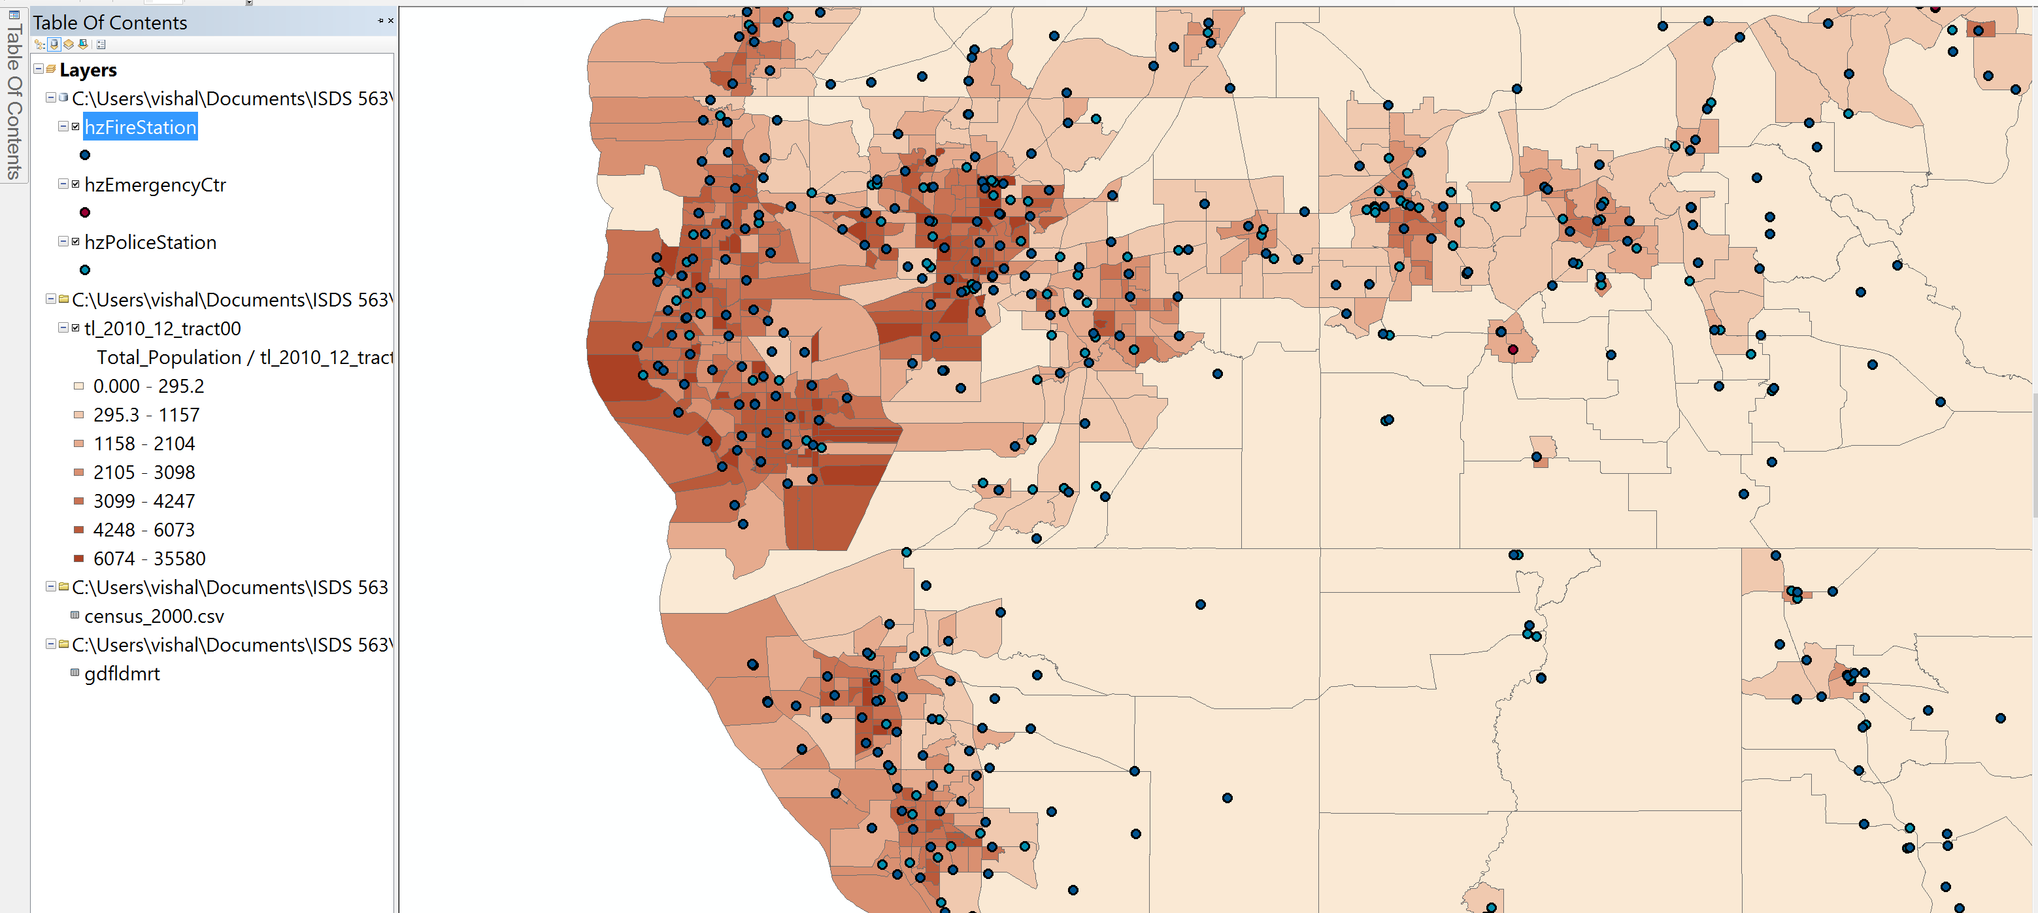
Population Density
County Population per square mile
Population Density with Emergency services

Slide 8
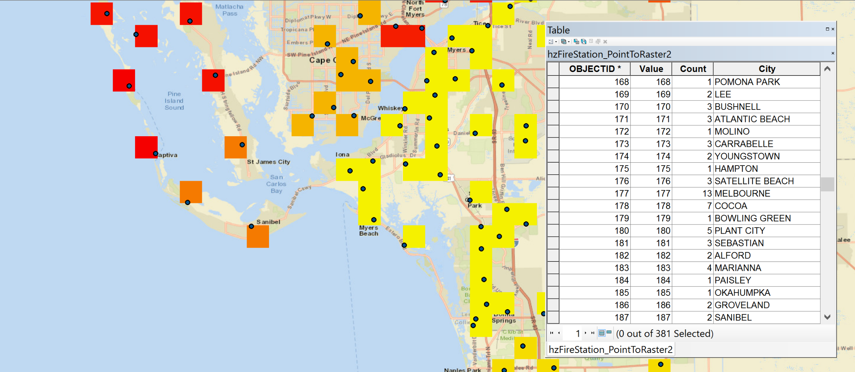
Rasterizing Emergency Services
Fire Services

Slide 9
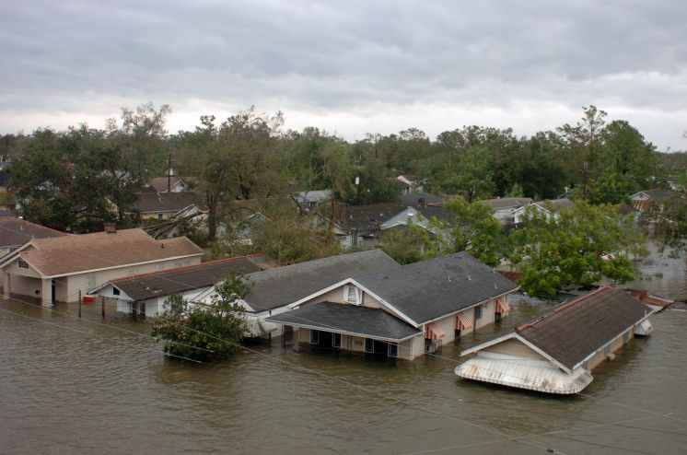
What Are We Going To Do?
Look for more geographical maps on potential environmental factors in Florida that contribute to flooding
Add city population data into our data set
If we cannot locate GIS data on a certain factor, we will use finished maps published by government agencies in our analysis

Slide 10
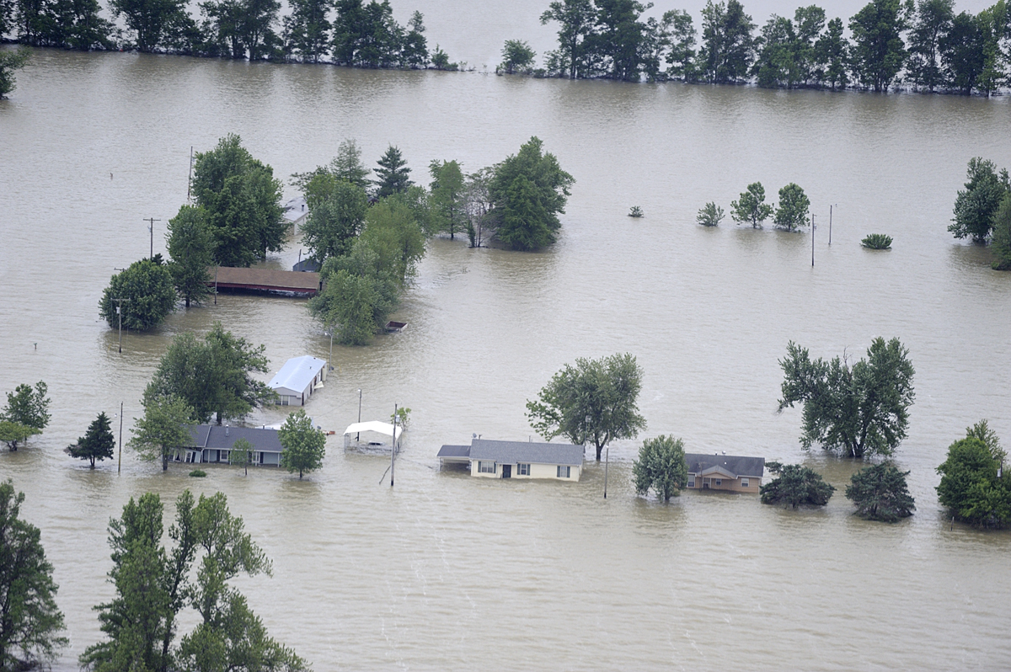
Problems Encountered
One of our biggest problem is having to convert all of our vector data sets into raster data sets
Finding data sets for small counties in Florida instead of the whole state
Finding data sets with confusing outputs
Data with no data dictionary to explain the meaning behind it

Slide 11
Our expectation
Use our end result flooding maps to show the relationship between Florida’s environmental/geographical factors, and how they can relate to flooding. In turn, these factors will contribute to our final model, which will show how to avoid an economic/human loss from any future Florida floods.

Slide 12

The End

